Slide 1
The Game of War: An Analysis through Simulation
Graham Wright and Ryan Burns

Slide 2
Goals
Analyze some of the game’s oddities
“The general who wins a battle makes many calculations in his temple ere the battle is fought. The general who loses a battle makes but few calculations beforehand.”
-Sun Tzu, The Art of War
Is there a strategy to increase your winning %?

Slide 3
Basics
Each player is dealt 26 cards randomly.
The game proceeds through a series of rounds and the winner takes all cards in play.
Round – Any time cards are played, which could be either a battle or a war, but not both.
Cards won go on the bottom of the deck and no shuffling of the deck is allowed between rounds.
A player wins when his opponent has no cards remaining.

Slide 4
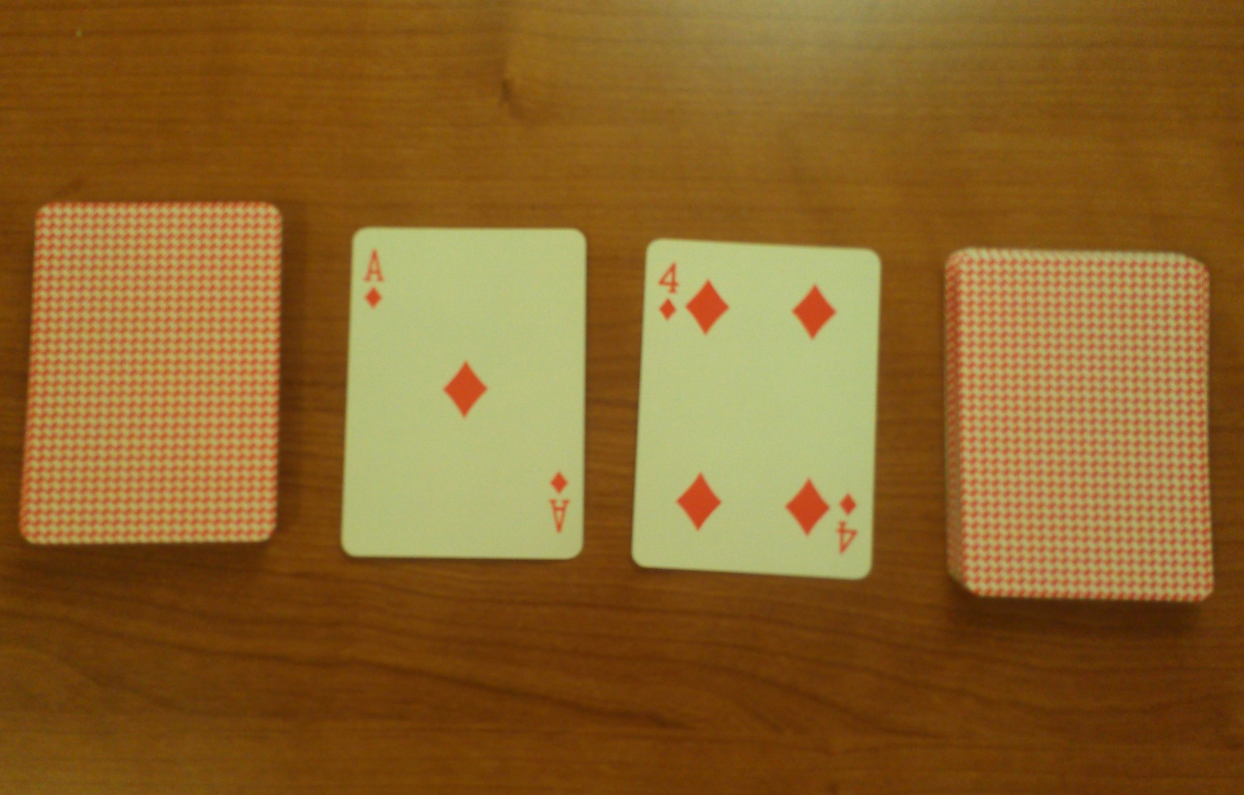
Battle
Battle – Each player places one card and one player wins (ex. A v 4)

Slide 5
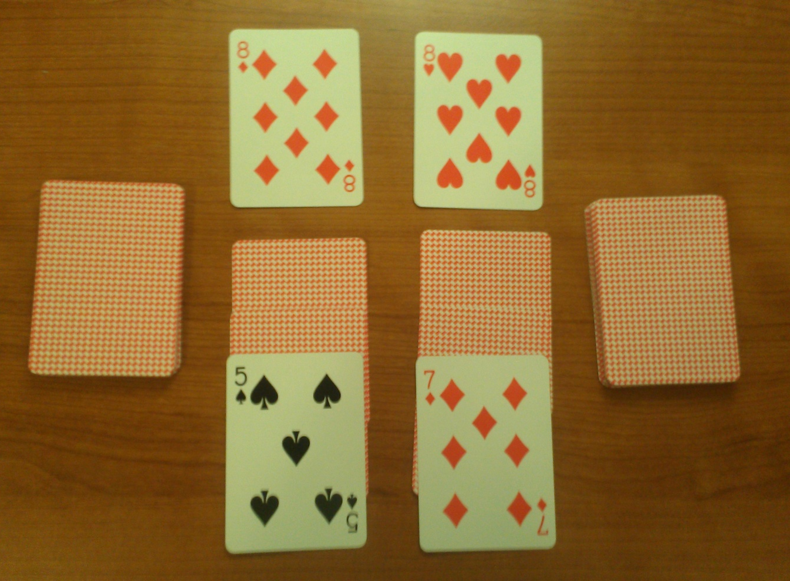
War
War – Both players place the same card, resulting in a tie (ex. 8 v 8)

Slide 6
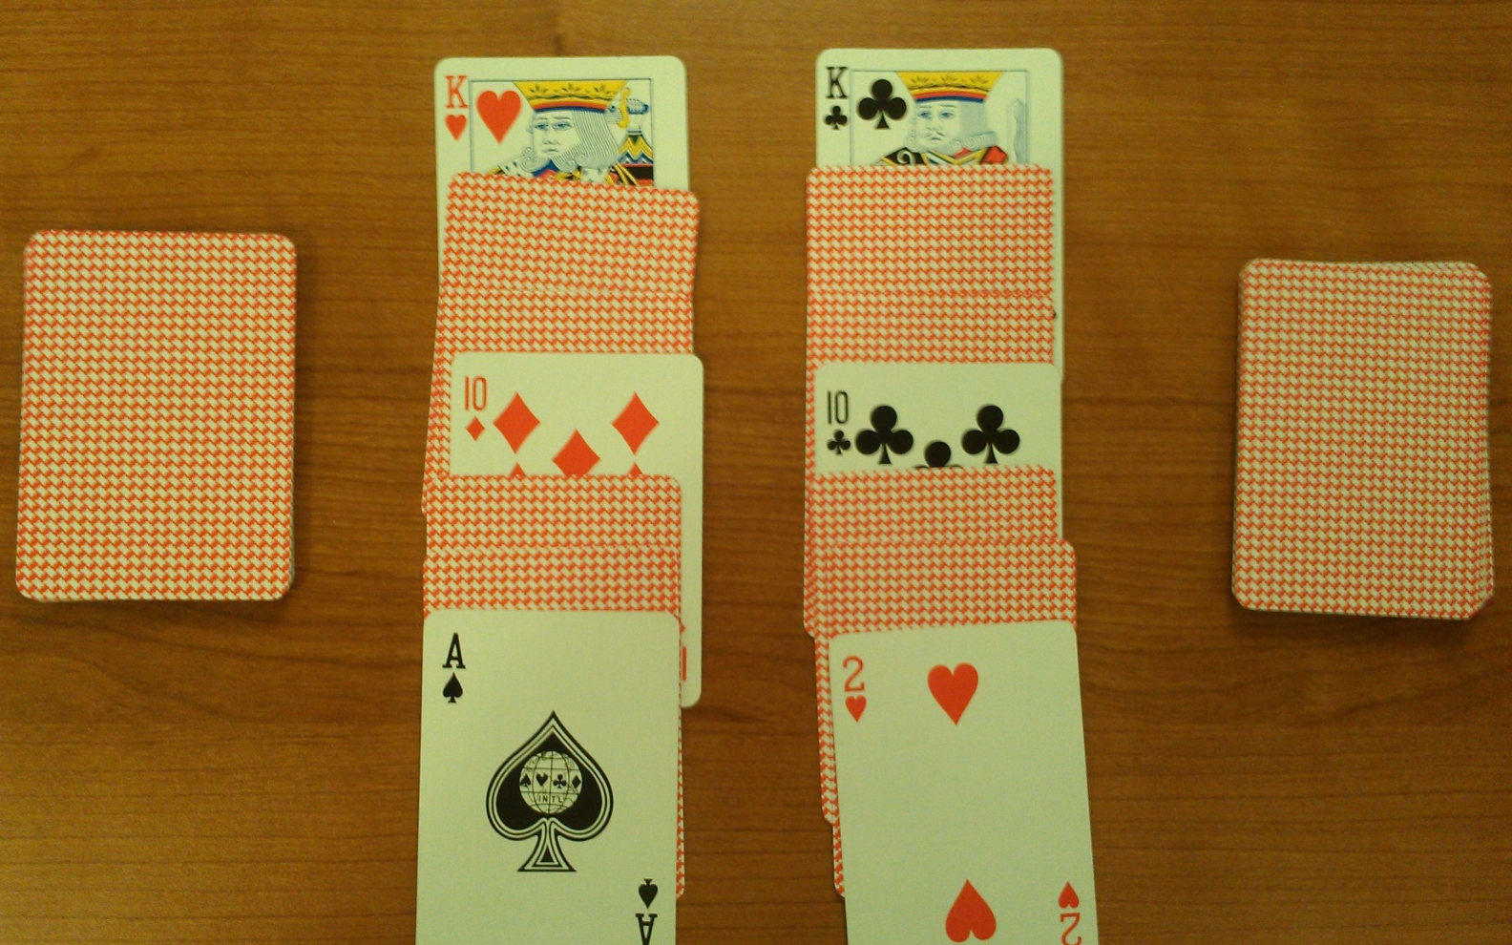
Double War
Double War – An example of an extended war, as this pattern can continue.

Slide 7
Statistics to be Analyzed
Average cards played, battles, rounds, and wars per game over 200 million games
Maximums and minimums
Frequency of extended wars
Relationship between strength of beginning hand and winning

Slide 8
Data Collection
[King, King, 6, 2, 6, 5, 6, Queen, Ace, Queen, 4, 8, Jack, Queen, 6, 10, 9, 3, 10, 9, 10, 5, Jack, 8, 2, 8, 9, Queen, Ace, 3, King, Jack, 3, Ace, 4, 7, 9, 2, 3, 4, King, 5, 7, 8, 7, Ace, 5, 2, 10, 4, Jack, 7]
Player 1: []
Size: 0
Player 2: []
Size: 0
Player 1: [2, 4, 5, 5, 3, Jack, Queen, 10, 2, Jack, 4, 9, 10, 8, 8, King, Queen, King, 5, 3, 6, 7, 10, 7, 9, Ace]
Size: 26
Player 2: [2, Jack, Jack, 5, Ace, 6, 2, 8, 9, 4, King, 7, 3, 7, Queen, Queen, King, 4, 8, 3, Ace, 10, 6, 9, 6, Ace]
Size: 26
Cards Played: 0
Rounds Played: 0
Battles Played: 0
Face off count: 0
Player 1: [2, 4, 5, 5, 3, Jack, Queen, 10, 2, Jack, 4, 9, 10, 8, 8, King, Queen, King, 5, 3, 6, 7, 10, 7, 9]
Size: 25
Player 2: [2, Jack, Jack, 5, Ace, 6, 2, 8, 9, 4, King, 7, 3, 7, Queen, Queen, King, 4, 8, 3, Ace, 10, 6, 9, 6]
Size: 25
Battle Pot: [Ace, Ace]
winners: 12
Cards Played: 2
Rounds Played: 0
Battles Played: 0
Face off count: 0
Player 1: [2, 4, 5, 5, 3, Jack, Queen, 10, 2, Jack, 4, 9, 10, 8, 8, King, Queen, King, 5, 3, 6, 7]
Size: 22
Player 2: [2, Jack, Jack, 5, Ace, 6, 2, 8, 9, 4, King, 7, 3, 7, Queen, Queen, King, 4, 8, 3, Ace, 10]
Size: 22
Battle Pot: [Ace, Ace]
tieDiscard Pile: [9, 7, 6, 9]
TieDecision Pile: [10, 6]
winners: 1
Cards Played: 8
Rounds Played: 1
Battles Played: 0
Face off count: 1
Player 1: [10, 6, 9, 6, 7, 9, Ace, Ace, 2, 4, 5, 5, 3, Jack, Queen, 10, 2, Jack, 4, 9, 10, 8, 8, King, Queen, King, 5, 3, 6]
Size: 29
Player 2: [2, Jack, Jack, 5, Ace, 6, 2, 8, 9, 4, King, 7, 3, 7, Queen, Queen, King, 4, 8, 3, Ace]
Size: 21
Battle Pot: [7, 10]
tieDiscard Pile: [
TieDecision Pile: [
Cards Played: 10
Rounds Played: 1
Battles Played: 0
Face off count: 1

Slide 9
Expected Counts
Averages per Game
Cards Played | 752.842
Battles | 298.883
Wars | 18.696 (11.033)
Rounds | 317.580

Slide 10
Extrema
 | Minimum | Maximum
Cards Played | 50 | 12328
Battles | 0 | 5026
Wars | 0 | 307
Rounds | 4 | 5083

Slide 11
Extended Wars
Type of War | Expected Count | Actual Count
Single | 18.696 | 3,739,244,650
Double | 1.094 | 218,847,131
Triple | 0.063 | 12,621,650
Quadruple | 0.0036 | 713,463
Quintuple | 0.000197 | 39,378
Sextuple | 0.0000107 | 2,134
Septuple | 0.000000495 | 99
Octuple | 0.000000025 | 5

Slide 12
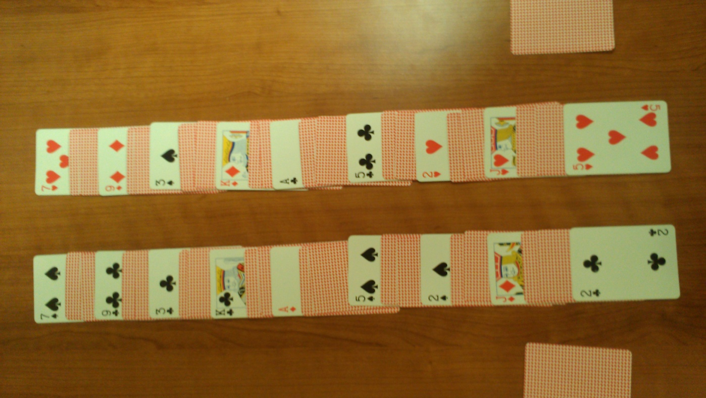
The Rare Octuple War

Slide 13
Aces’ Impact
Number of Aces | Occurrence of Winning in this State | Probability of Winning
0 | 0.019 | 0.174
1 | 0.166 | 0.333
2 | 0.39 | 0.5
3 | 0.333 | 0.667
4 | 0.091 | 0.826
Average Winner Ace Count : 2.311

Slide 14
Strength of Hand’s Impact
Average Hand = 2(2+3+…+13+14) = 208
Starting Hand | Occurrence of Winning in this State | Probability of Winning
< 208 | 0.398 | 0.41
> 208 | 0.573 | 0.59
== 208 | 0.029 | 0.5
Average Winner Hand Strength: 210.783

Slide 15
Returning Your Winnings
Strategy 1 : (high - low) - (high - low)
winning pct. = 46.19%
Strategy 2 : (low - high) - (low - high)
winning pct. = 41.84%
Strategy 3 : (high - low) - (low - high)
winning pct. = 47.96%
Strategy 4 : (low - high) - (high - low)
winning pct. = 48.03%

Slide 16
Pregame Sorting and its Effect
Low to high - (2 2 3 3 … K K A A)
winning pct. = 52.59%
High to low - (A K K Q … 3 3 2 2)
winning pct. = 57.75%
Alt. from the top - (A 2 A 3 … 9 7 8 8)
winning pct. = 49.57%
Alt. from the bottom - (8 7 9 7 … 3 K 3 A)
winning pct. = 48.26%

Slide 17
An Infinite Game of War?
Returning cards in the same order they were played allows for infinite war occurrences
If the winner returns the winnings to the bottom of the deck, p1’s first, then p2’s, an alternating high to low pattern forms
This pattern will cause p1 and p2 to win every other hand, forever

Slide 18
Infinite Cycle in Action
Player 1: [7, King, 9, Jack, 5, Ace, 3, 9, 2, King, 5, 6, 6, Queen, 4, 6, 2, Ace, 4, 10, 8, Jack, 6, 9, 3, Queen]
Size: 26
Player 2: [King, 10, Queen, 2, Queen, 8, King, 2, Jack, 3, 8, 5, 7, 4, 10, 8, Jack, 4, 9, 7, Ace, 3, Ace, 5]
Size: 24
Battle Pot: [7, 10]
Player 1: [7, King, 9, Jack, 5, Ace, 3, 9, 2, King, 5, 6, 6, Queen, 4, 6, 2, Ace, 4, 10, 8, Jack, 6, 9, 3]
Size: 25
Player 2: [10, 7, King, 10, Queen, 2, Queen, 8, King, 2, Jack, 3, 8, 5, 7, 4, 10, 8, Jack, 4, 9, 7, Ace, 3, Ace]
Size: 25
Battle Pot: [Queen, 5]

Slide 19
Strategy for Success
The best strategy is no strategy at all
“The general who wins a battle makes many calculations in his temple ere the battle is fought. The general who loses a battle makes but few calculations beforehand.” -Sun Tzu, The Art of War
“The general who wins a battle makes but few calculations in his temple ere the battle is fought. The general who loses a battle makes many calculations beforehand.”
-Reality
WRONG

